Slide 1
Lectures 02 and 03 – Fundamental Principles
2017.08.23 and .25
It has long been an axiom of mine that the little things are infinitely the most important.
– Arthur Conan Doyle

Slide 2
Announcement
Bring clicker, paper, and writing implement to lecture

Slide 3
Assignment
Homework 01 due Wed 08/30, see Blackboard course content homework folder
Finish reading textbook Chapters 1 and 2 before next lecture

Slide 4
Homework grading method
Each graded solution evaluated on a 3-point scale
0 – no solution shown; “Left it blank.”
1 – minimal progress towards a correct answer shown
2 – substantial progress shown, but either stopped short of a correct answer or reached an incorrect answer
3 – a correct answer, modulo inconsequential issues
Homework score reported in Blackboard as the percentage Earned Points/Available Points

Slide 5
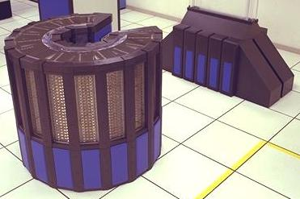

From last time: Computing is change
Cray-2 (May 1985)
Fastest computer on the planet
Processors: 4, custom, 244 MHz clock
Main memory: 1.0 GByte
Volume: 1.5 m³ Mass: 2,500 kg
Power: 200 kilowatts (~$500/day)
Cost: circa USD $15 million
Just as fast on a benchmark program
Processor: 2 core ARM Cortex-A9
Main memory: 0.512 GByte
Volume: 4x10⁻⁴ m³ Mass: 0.61 kg
Power: 3 Watts (< $0.01/day)
Cost: USD $499
Apple iPad 2 (March 2011)
Notes:
L01 ENDED here Aug. 21 LE1.

Slide 6
Computer architecture and extreme change
To plan for the evolution of computer hardware, designers and programmers must watch for
rate of change of current technologies
new technologies
E.g., Moore’s Law for integrated circuits (chips)
(1965 – 2003) Feasible transistor count for a chip increases 40% to 55% per year, that is, doubling in 18 to 24 months
Transistor count approximates the capability and speed of the circuit of a chip
Notes:
We will see how adding transistors increases capability and speed.

Slide 7
Setting the stage for today
Mass-produced microprocessor chips ride the manufacturing improvements of Moore’s Law to ever lower costs
Faster, bigger hardware eliminates most need for assembly language programming
UNIX and its clone, Linux, leverage C, a high-level assembly language, to create a vendor-independent operating system
1986 – 2003 computer performance increased 50%/year

Slide 8
What is the result?
Hardware cost/performance improvements mean
Nearly everyone has access to a computer today
New classes of computers emerge
Personal computers and workstations (1980s)
Smart phones, warehouse computers (2000s)
Internet of Things (2010s)
Microprocessor-based computers dominate across the entire range of computer design
Software development transformed

Slide 9
What is the result? (part 2)
25,000-fold hardware performance improvement since 1985 means
New applications possible: speech recognition, video streaming, big data analytics, etc.
Programmers today trade away execution performance to gain programmer productivity
In place of performance-oriented languages such as C and C++, more programming is done in managed languages including Java and C#
Python and Ruby scripting languages, even more productive of programmer time, gaining usage
Notes:
NEW APPLICATIONS: Talk about 60 sec NTSC black and white video grabber in Malcolm’s lab and now he is coding to tag all video for Google.
A specialized box, size of a dishwasher to play, reverse, slow-mo, and freeze-frame costing ~$30,000

Slide 10
Popular computer architectures today
Intel x86 family
Laptop computers
Desktop computers
Servers
Warehouse (cloud) computers
ARM
All smartphones, tablets
Your CS250 lab kit

Slide 11
Computer performance since 2003
Improving only ~20%/year because
Faster microprocessor circuits too hot to air-cool
Memory circuit speed significantly lagging
Limited assembly-language-level parallelism for the hardware to exploit
Forced, and still forcing today, an historic switch to multicore processors and explicit parallelism in programs
Applications must be restructured by programmers and compilers
Notes:
We will address these issues in more detail during the semester.

Slide 12
Computer Architecture
Computer architecture is the design and organization of a computer
driven by fundamental requirements for computing
driven by available technologies
Computer architecture affects
the design of software and
practical limits of computation
Notes:
END????

Slide 13
Aspects of computer architecture
Instruction set design: what software instructions can the hardware execute?
Functional organization: how is the hardware partitioned into specialized units?
Logic design: what specific logic circuits are used and how are they organized?
Implementation: what technologies and packaging are used?
Notes:
Maybe fix bullet 3:

Slide 14
Aspects of computer architecture
Power/energy: how much for user’s program?
Parallelism: how to do more per unit time?
Performance: how to assess the merits of various computers from the viewpoint of a user?
Price: how many users can afford the computer?
Summary: computer architecture embodies many decisions and trade-offs

Slide 15
Computing machines
Key insight by Alan Turing: Automate computation by building a machine to carry out a definite method on a finite set of symbols
Definite method is specific enough to correspond to a fixed machine design
Finite set of symbols makes machine input and output manageable
What are the implications of this design?

Slide 16
Why “finite set of symbols”?
The world is analog
temperatures, distances, all parameters in the large world (not quantum-scale world) have possible values best expressed as real numbers
Real numbers are an infinite cardinality set
Increasingly expensive and difficult to build an electrical circuit that can quickly distinguish, say
0.500000 volts from 0.499999 volts (0.000001 ∆V)
0.500000000 V from 0.499999999 V (0.000000001 ∆V)

Slide 17
Computing with analog values
Analog values are real numbers, so values require an infinite number of digits to represent
Infinite number of digits requires infinite hardware implying cost = $∞ (!!!)
Thus, a machine representation of an analog value must contain some amount of error, ϵ
Example comutation: ideal addition A[1] +A[2] = sum{A[i]} becomes actual A[1]+ϵ[1] + A[2]+ϵ[2] = sum{A[i]} + sum{ϵ[i]}
Error accumulates with each computational step
Notes:
For the game of telephone:

Slide 18
Solve problem of error accumulation
Sum {ϵ[i]} for i=1 to n is unknowable
Sum {ϵ[i]} can grow without limit, or
Sum {ϵ[i]} might mostly cancel out
Cannot know what portion of an analog-computed result is error
For calculations of more than a few steps, obtaining useful results requires a way to represent values without error
Solution: give up expressiveness of analog and compute on a finite set of values that can be represented without error

Slide 19
Simplest symbol set: Unary, or base 1
Unary has one symbol; used for tallying
To represent the number A write the chosen symbol, say, slash /, A times
Let A be //////
Let B be /////////////////
Then A + B is ///////////////////////
Unary number A uses O(A) space ⇒ O(A) hardware to store the number A
What does + mean in unary?
+ means concatenate the symbol strings
So, time to add a pair of numbers is O(A+B), not O(1)

Slide 20
Better: weighted positional, base 10
Number written as series of digits d∊ {0, 1, 2, 3, 4, 5, 6, 7, 8, 9} where value of digit is weighted by its position
Number A written in O(log A) symbols; much less space and hardware than Unary
A + B takes O(log(A+B)) time, much faster
d_{i}x10^{i} + d_{i-1}x10^{i-1} + … + d₁x10¹ + d₀x10⁰
↑ ↑
Most significant digit Least significant digit

Slide 21
Representing symbols
Use voltage because transistor circuits can sense and react to voltage values very quickly
Base 10 requires
10 voltage levels corresponding to {0,1,…,9}
However, typical electrical part has ±5% to ±20% variance from nominal value
Cheaply building many circuits with 10 voltage levels that match well is difficult
Look for a weighted positional symbol set needing fewer voltage levels

Slide 22
Simplest weighted positional: base 2
Unlike unary, base 2 (binary) has logarithmic, not linear, time and space complexity
Electrical circuit need only move between and distinguish two different voltage levels: cheapest and fastest choice
Distinguishing symbols requires that the chosen voltages be sufficiently different
Electrical part variation requires acceptance of a range of voltages for each symbol

Slide 23
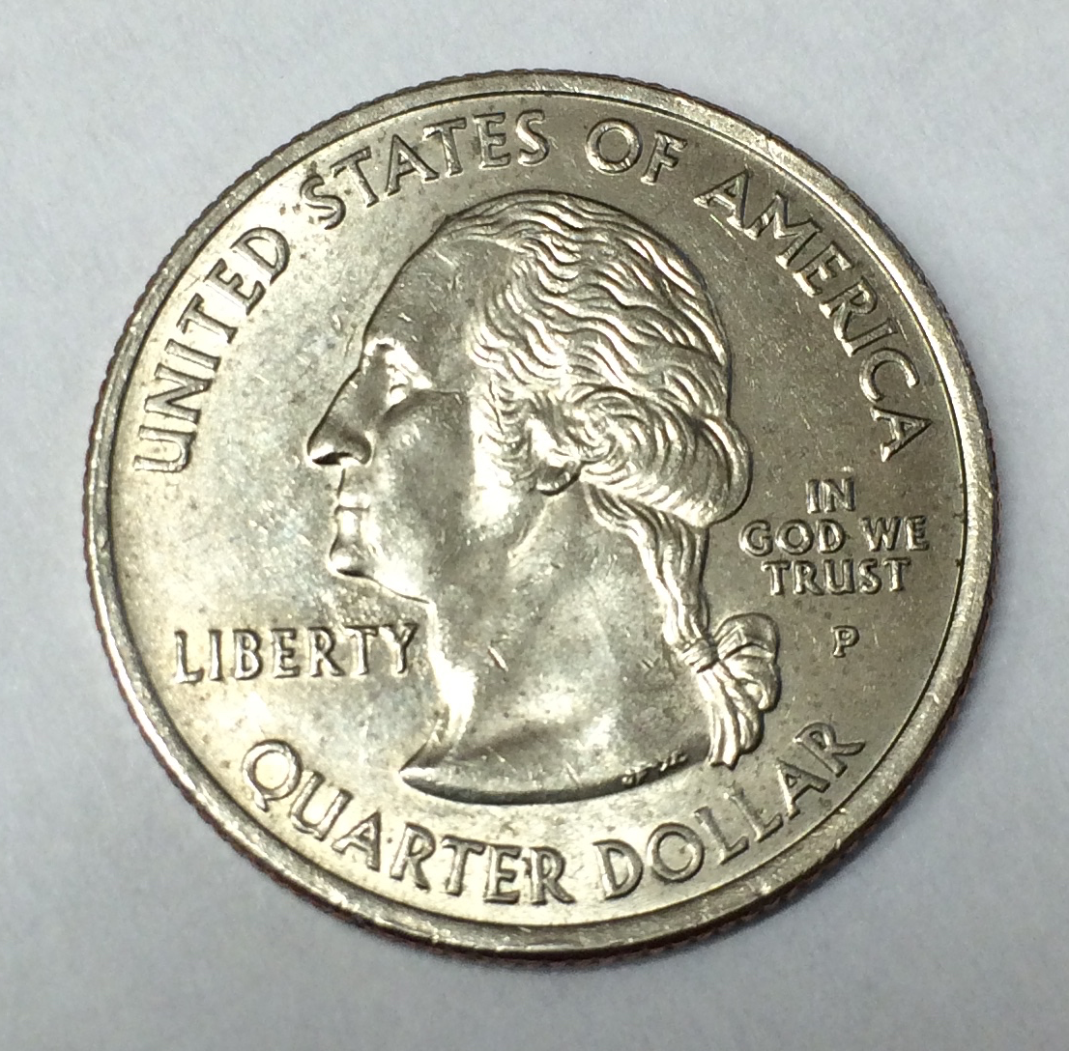
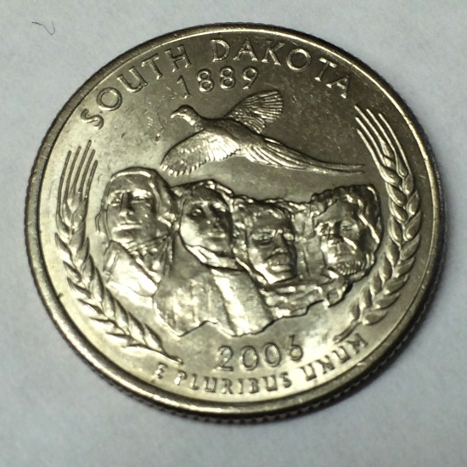


Example two-symbol systems
Heads and tails
Modulo 2 arithmetic:
Statements: Sentences that are either
1 + 1 = 0
True/False ambigram © Scott Kim
Notes:
Ended LE1 here

Slide 24
Algebras
There are many different algebras
An algebra is like a mathematical set of gears and linkages, a machine
An particular algebra describes the elements of its set and how operations if the algebra manipulate them
Grade school algebra
Elements are the set of Rational or Real Numbers
Manipulations are the binary operations (operations that take two operands) known as +, –, x, and /
We are designing a 2-symbol computational machine
We need an algebra on a set with two elements and operations easy to build with electronic circuits

Slide 25
Boolean algebra, an algebra to describe computers
George Boole, mathematician develops a 2-symbol, three operation algebra in 1847
A Boolean algebra is a set {0,1} on which are defined two binary operations + and ⦁ and one unary operation ’ such that the following properties hold for all x, y, z ∈ {0,1}
Commutative property for + and ⦁ x+y = y+x and x⦁y = y⦁x
Associative property for + and ⦁ x+(y+z) = (x+y)+z and x⦁(y⦁z) = (x⦁y)⦁z
Distributive properties for ⦁ over + and + over ⦁ x⦁(y+z) = (x⦁y)+(x⦁z) and x+(y⦁z) = (x+y)⦁(x+z)
Identity properties x+0 = x and x⦁1 = x
Complementation x+x’ = 1 and x⦁x’ = 0

Slide 26
Boolean algebra, an algebra to describe computers
George Boole, mathematician develops a 2-symbol, three operation algebra in 1847
A Boolean algebra is a set {0,1} on which are defined two binary operations + and ⦁ and one unary operation ’ such that the following properties hold for all x, y, z ∈ {0,1}
Commutative property for + and ⦁ x+y = y+x and x⦁y = y⦁x
Associative property for + and ⦁ x+(y+z) = (x+y)+z and x⦁(y⦁z) = (x⦁y)⦁z
Distributive properties for ⦁ over + and + over ⦁ x⦁(y+z) = (x⦁y)+(x⦁z) and x+(y⦁z) = (x+y)⦁(x+z)
Identity properties x+0 = x and x⦁1 = x
Complementation x+x’ = 1 and x⦁x’ = 0
Blue = differences vis-à-vis grade school algebra on real numbers.

Slide 27
Statements and Boolean Logic
Denote statement truth values using 2 symbols, typically {T,F} or {0,1}
Example statements
Statement A: “10 < 7”
Statement B: “Today is Friday”
Notes:
This slide works for a lecture given on Friday; adjust as needed

Slide 28
Logically inverting statements
Can invert the truth of statements using NOT
“10 ≮ 7” also “Today is NOT Friday”
Truth table for NOT A , A’
A | A’
F | T
T | F
A | A’
0 | 1
1 | 0

Slide 29
Boolean algebra assumes “perfection”
Boolean algebra has exactly 2 symbols: discrete
Computations of interest have many steps, each with Boolean algebraic actions to perform
Each Boolean step produces a result represented exactly in {0,1} and can pass result to next step as a perfect input
A perfect system, like a perfect vacuum, exists only in the mind
What happens when we try to build a physical machine to implement Boolean algebra?

Slide 30
Modeling discrete in the real world
Circuit reality check
Due to manufacturing variability, exactly identical electrical components are not feasible
Thus, circuit voltage not one of two perfect values
For multi-step computations may want to re-use a logic circuit to control costs
Thus, circuit input and output (result) voltages will represent both elements of {0,1} over time as successive data is processed
A real circuit cannot instantaneously change between two distinct voltages, so other voltages will be present

Slide 31
Digital: sufficiently approximating perfection
Circuit can produce two distinct output voltages, using power supply and ground as two references (say, +5 V and 0 V)
Circuit can easily be built to process any input voltage falling within a reasonable range of +5 and 0 as if it were the ideal value
Circuit can be built to change output voltage quickly, so intermediate values appear briefly
Circuit behaving as above is called digital

Slide 32
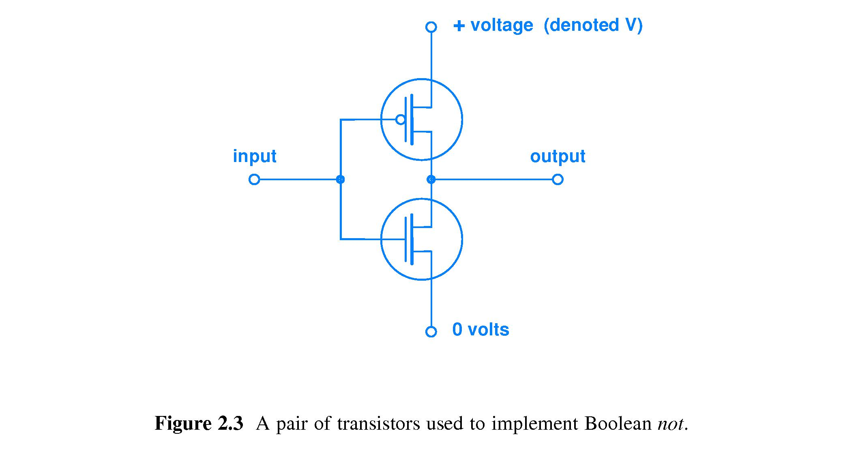
Circuit to perform Boolean NOT
Let 0 mean low voltage and 1 mean high voltage
Input = 0
Output = 1
Input = 1
Output = 0

Slide 33
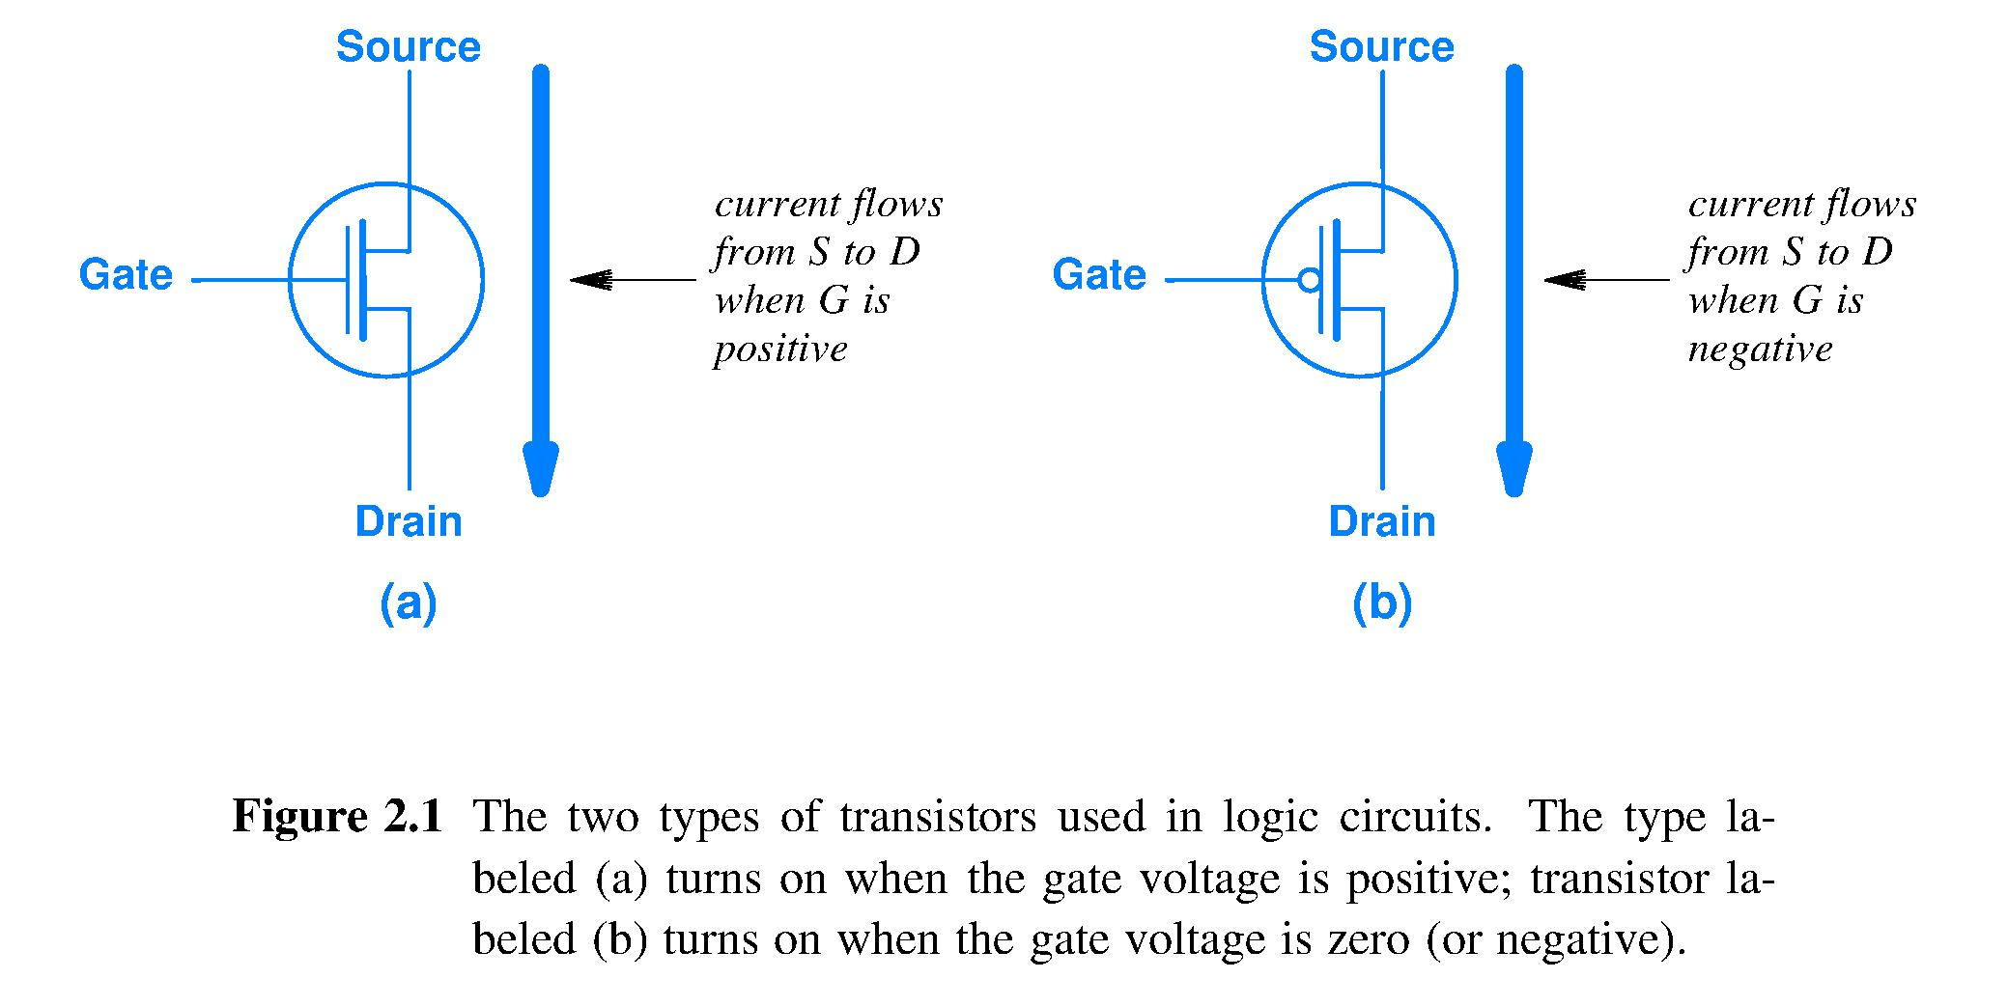
Electrically controlled On/Off switch
Metal-Oxide-Semiconductor Field Effect Transistors (MOSFETs) can act as an ON/OFF switch
Gate voltage turns the path between the Source and Drain ON or OFF (low resistance or high resistance)
Symbol for MOSFET that Added “dot” means CONNECTS with high Gate MOSFET disconects

Slide 34
Circuit to perform NOT
Power supply reference voltages for generating high quality, near ideal, output voltage
Both MOSFET gates are connected to the same node, “input,” so both MOSFETs have the same gate voltage all the time
Notes:
A more abstract circuit schematic.

Slide 35
A two-MOSFET digital circuit
Acceptable input voltage ranges shown in yellow. Input voltage may degrade during transit from the circuit creating this signal to the Gate of this MOSFET.
Output
voltage
at the
high-
quality
edges of
the
allowed
voltage
bands.
Digital
circuit
restores
logic
signal
quality.
V
}
V
ON
OFF
Voltage
Voltage
OFF
}
ON
0
0

Slide 36
Complementary MOSFETs (CMOS)
A secret behind the success of Moore’s Law is a rule:
“Turn off the lights when they are not needed.”
Complementary MOSFETs made this easy.
Same gate voltage all the time means only for an instant, when the input changes value, will both MOSFETS be between ON and OFF, that is, both somewhat ON.
Circuit energy use (flow from +V input to 0 volts) occurs mostly during brief transition. Thus, CMOS is a very low energy circuit.
CMOS is thus very low power even when switched FAST.
Notes:
How many have heard the term CMOS?
We see a more abstract circuit schematic here, to keep the focus right were we need it.
“Switched” is what a circuit does when we put it to WORK.

Slide 37
Combining statements
Can combine statements A, B using AND to obtain a more complex statement
“10 < 7 and Today is Friday”
What is the truth or falsehood of the combination?
A AND B = A∧B = AB truth tables using {T,F}, {0,1}
A | B | A B
F | F | F
F | T | F
T | F | F
T | T | T
A | B | A B
0 | 0 | 0
0 | 1 | 0
1 | 0 | 0
1 | 1 | 1
Notes:
This slide works for a lecture given on Friday; adjust as needed

Slide 38
Combining statements with OR
Can combine statements using OR
“10 < 7 or Today is Friday”
Truth table for A OR B, A∨B, A+B
A | B | A + B
F | F | F
F | T | T
T | F | T
T | T | T
A | B | A + B
0 | 0 | 0
0 | 1 | 1
1 | 0 | 1
1 | 1 | 1

Slide 39
How many 2-input operations?
Define an arbitrary 2-input operation with symbol ☉ by filling in its truth table:
Defining ☉ requires 4 independent choices from a set of 2 symbols, there are 2⁴ ways ∴ 2⁴ = 16 2-input operations
A | B | A ☉ B is defined by choices made
0 | 0 | Chose one from {0,1} to define 0☉0
0 | 1 | Chose one from {0,1} to define 0☉1
1 | 0 | Chose one from {0,1} to define 1☉0
1 | 1 | Chose one from {0,1} to define 1☉1

Slide 40
Key knowledge
Memorize the truth tables of these seven operations: AND, OR, NOT, NAND, NOR, XOR, XNOR
Become able to
construct these truth tables rapidly from memory
mentally envisage these truth tables and extract a truth value using only your mind
compare and contrast the tables of different operations

Slide 41
Logical NAND operation, (AB)’
A | B | A NAND B
0 | 0 | 1
0 | 1 | 1
1 | 0 | 1
1 | 1 | 0
NAND is the negation of the Boolean AND operation
This truth table is a definition of the NAND operation

Slide 42
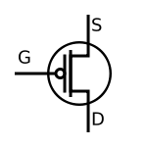
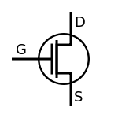
Circuit for (AB)’ – fundamental idea
Parallel paths from +V to Out. If either or both transistors is On, if either or both input A or B is high, Out = +V
+V voltage
A
B
Out
A
Series path from 0 volts to Out. Both transistors must be On, both inputs A and B must be low, to make Out = 0 volts
B
0 volts

Slide 43
Logical NOR operation, (A+B)’
Truth tables are a kind of software
They define an operation, or function
They are abstract: A, B stand for any pair of statements
Given an A and a B, the table says what the output must be (although it does not say how to produce it)
A | B | A NOR B
0 | 0 | 1
0 | 1 | 0
1 | 0 | 0
1 | 1 | 0
Notes:
Just what are we looking at here?

Slide 44
Summary
Automating computing means using a machine
Using machines to compute depends on finite symbol sets
In an analog world, error accumulates
We can make machines that behave digitally, that use a fixed, finite set of values
Finite symbol sets match manufacturing capability
Clear symbol distinguishability reduces errors, typically to a vanishingly small error rate
Key concepts to achieve the above
Binary (and higher-radix) number systems
Weighted positional notation so that number of symbols is the log of the range of the values

Slide 45
Summary
We build digital circuits from Complementary MOSFET transistors, called CMOS for short
Boolean algebra describes operations on set with two elements, basis for describing the logic we use in electronic computers
Powered HW is always active

